Slide 1


A Generative Model of Target Switching Behaviour in Visual Foraging
A. Clarke, A. Hunt & A. Hughes

Slide 2
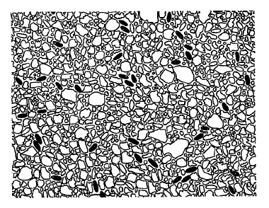
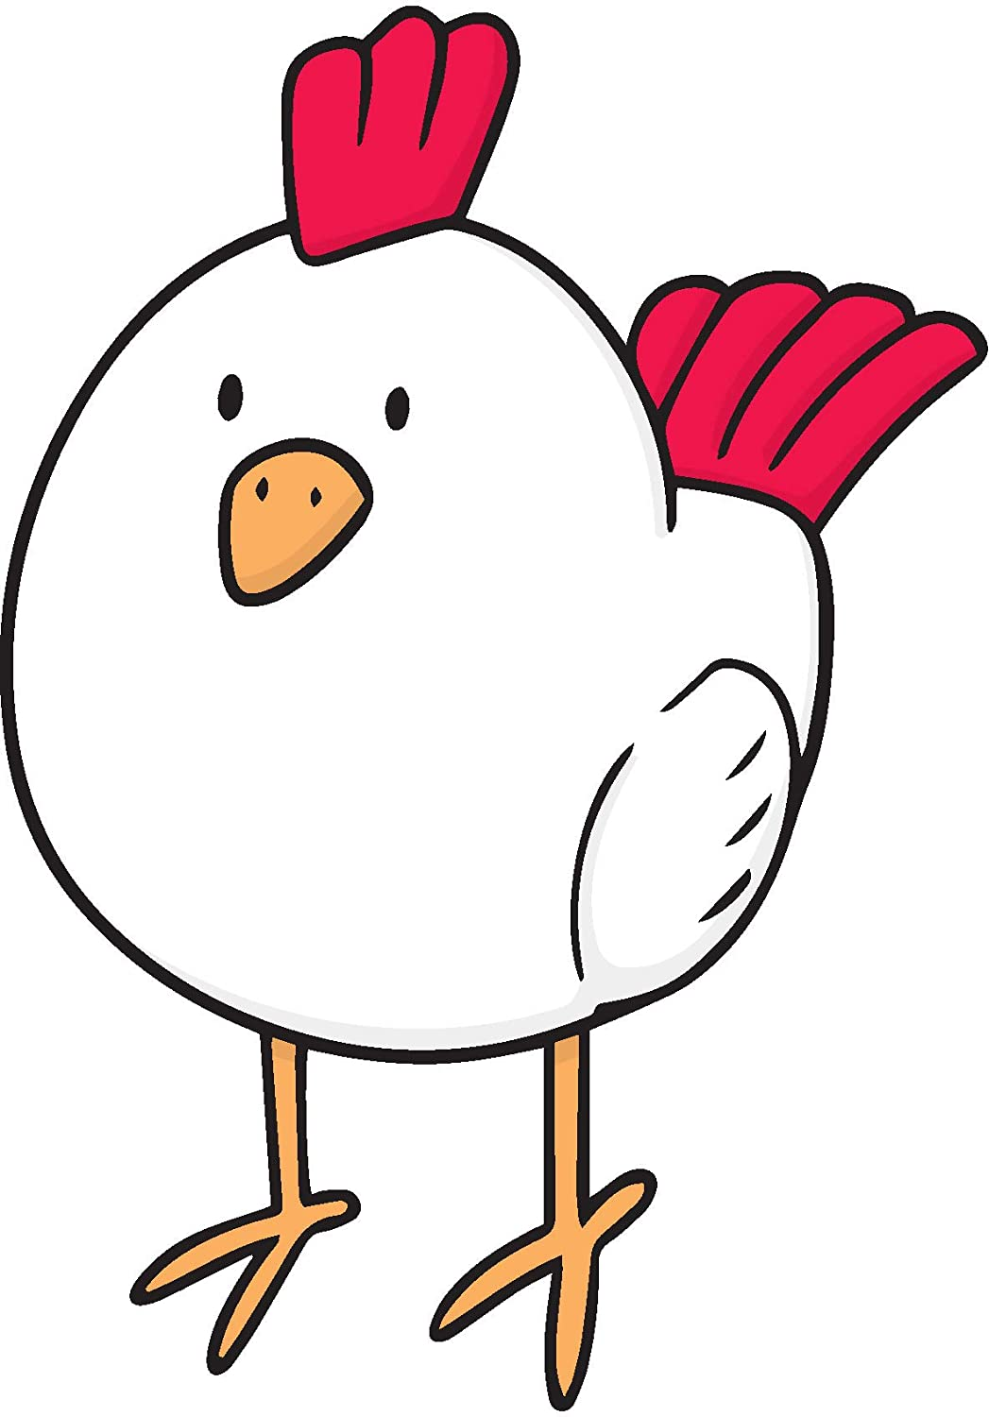
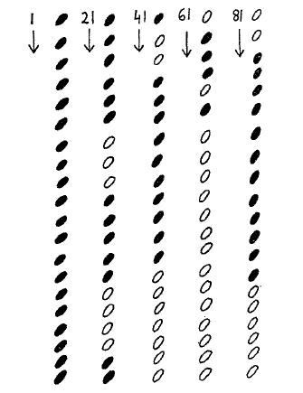
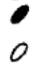
Intro: chickens
There are two types of grain:
The chicken pecks grains in runs of one grain, and then the other.
Dawkins (1971)

Slide 3
Run length summary statistics
Previous research has used run length statistics.
The data is represented as:
26, 3, 5, 4, 3, 2, 10, 8, 3, 1, 1, 16, 12, 6
Then we summarise the trial with:
Maximum run length = 26
Number of runs = 14
We can calculate these for every trial, before applying our favourite statistical analysis.

Slide 4
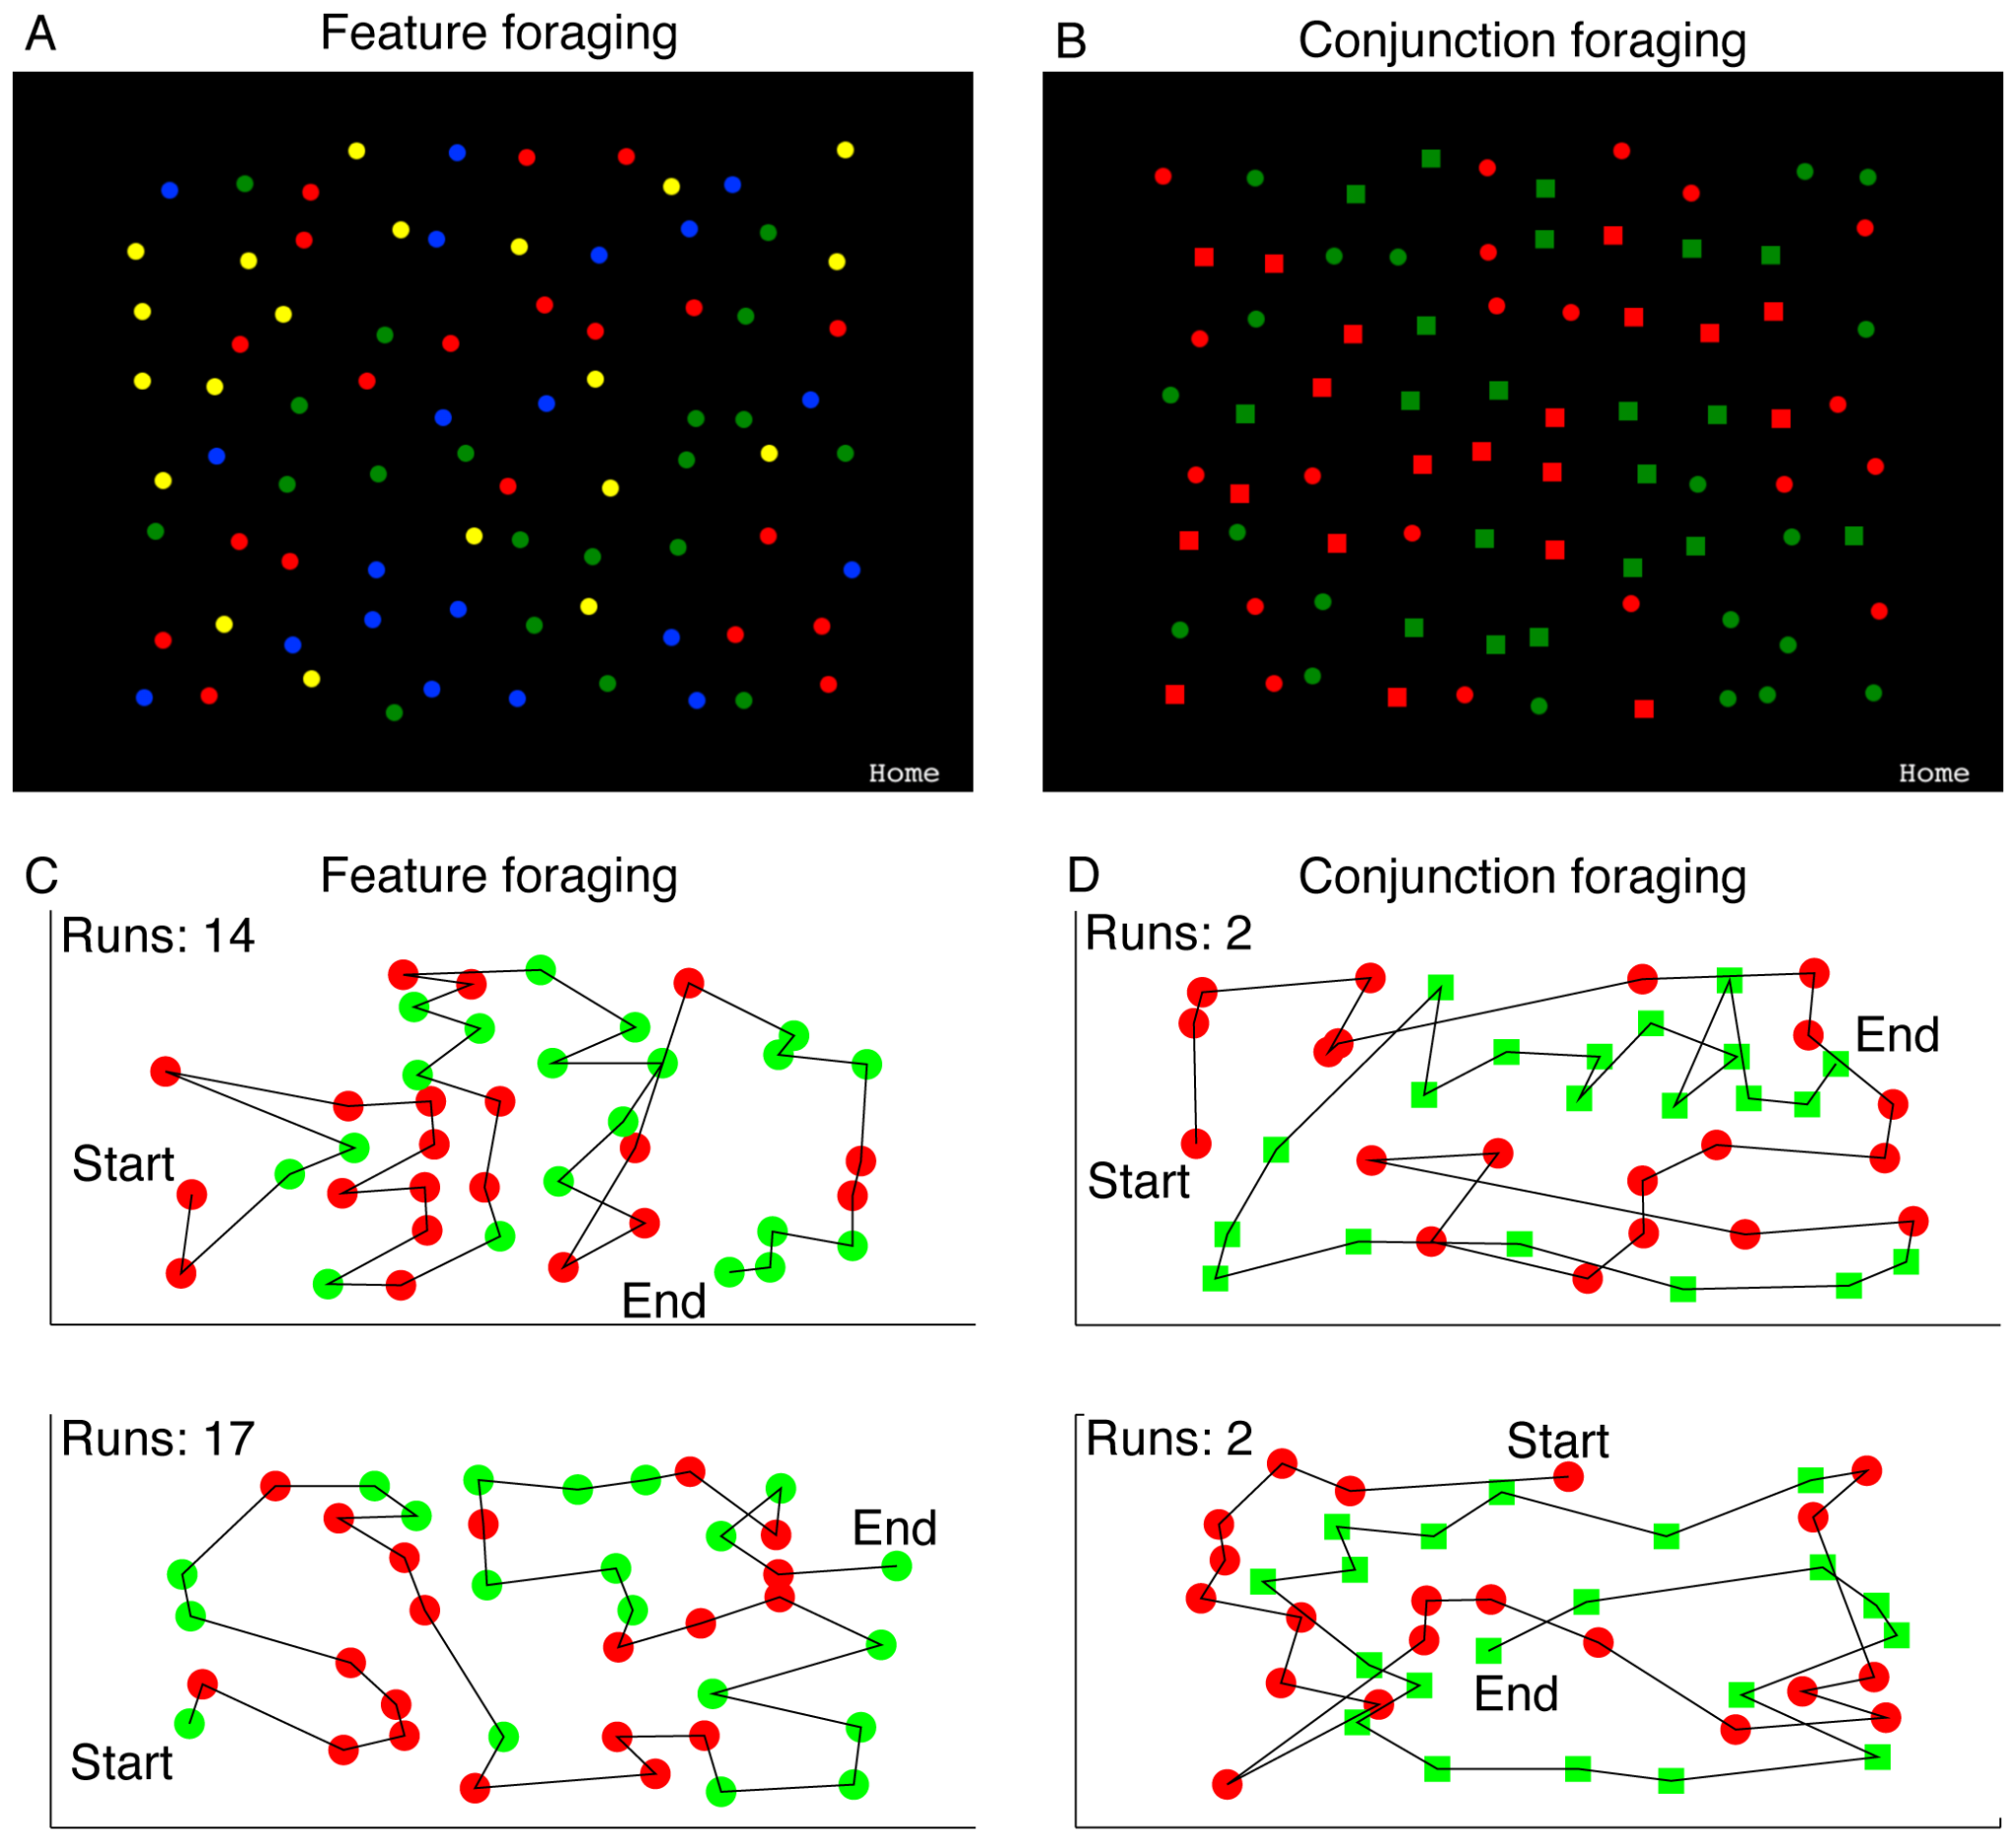
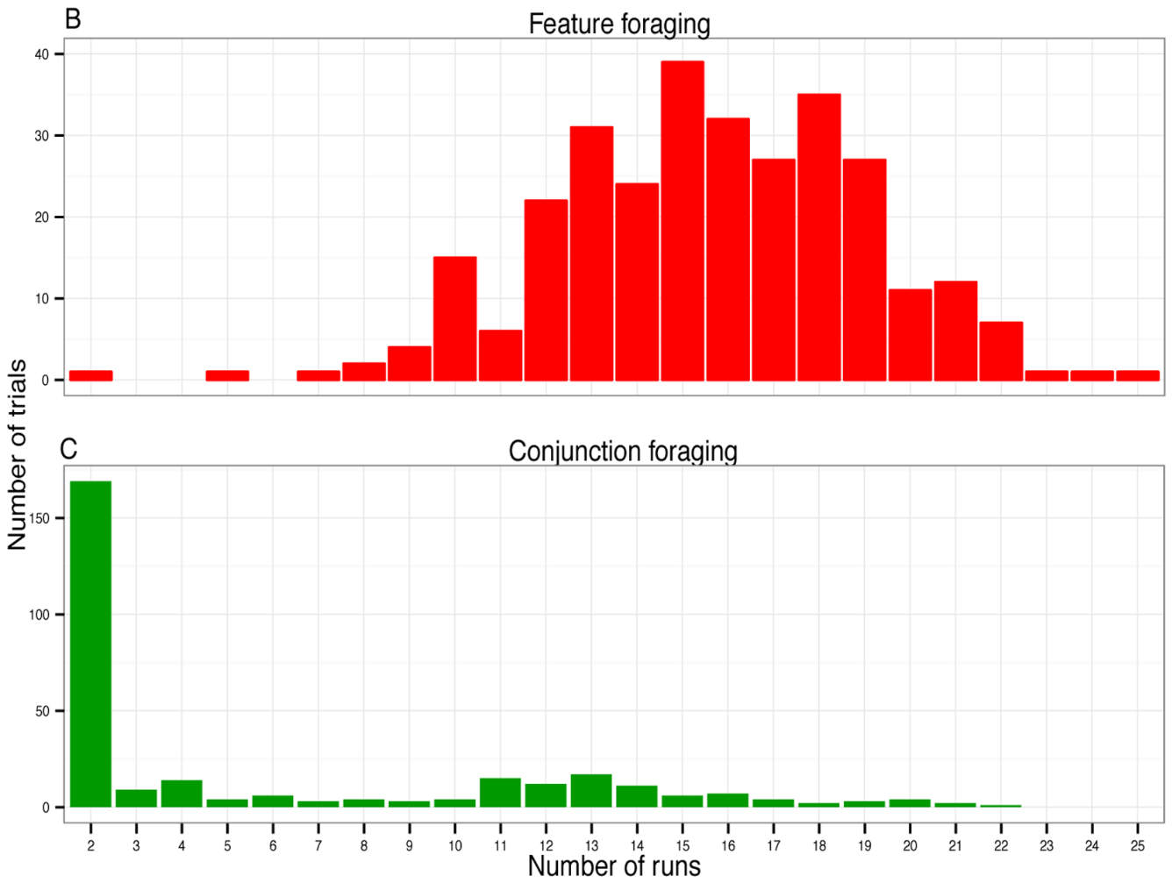
Intro: human participants
targets:
Similar behaviour has been found with human participants.
In conjunction foraging, this behaviour is more extreme - most participants favour a small number of long runs.
Kristjánsson et al (2014)

Slide 5
Last Year at ECVP
We introduced a generative model that can account for a participant’s behaviour using just 4 parameters:
Salience/value preference
Stick v switch preference
Proximity tuning
Direction tuning
(details outside scope of this talk)
Clarke, A. D., Hunt, A. R., & Hughes, A. E. (2022). Foraging as sampling without replacement: A Bayesian statistical model for estimating biases in target selection. PLoS Computational Biology, 18(1).

Slide 6
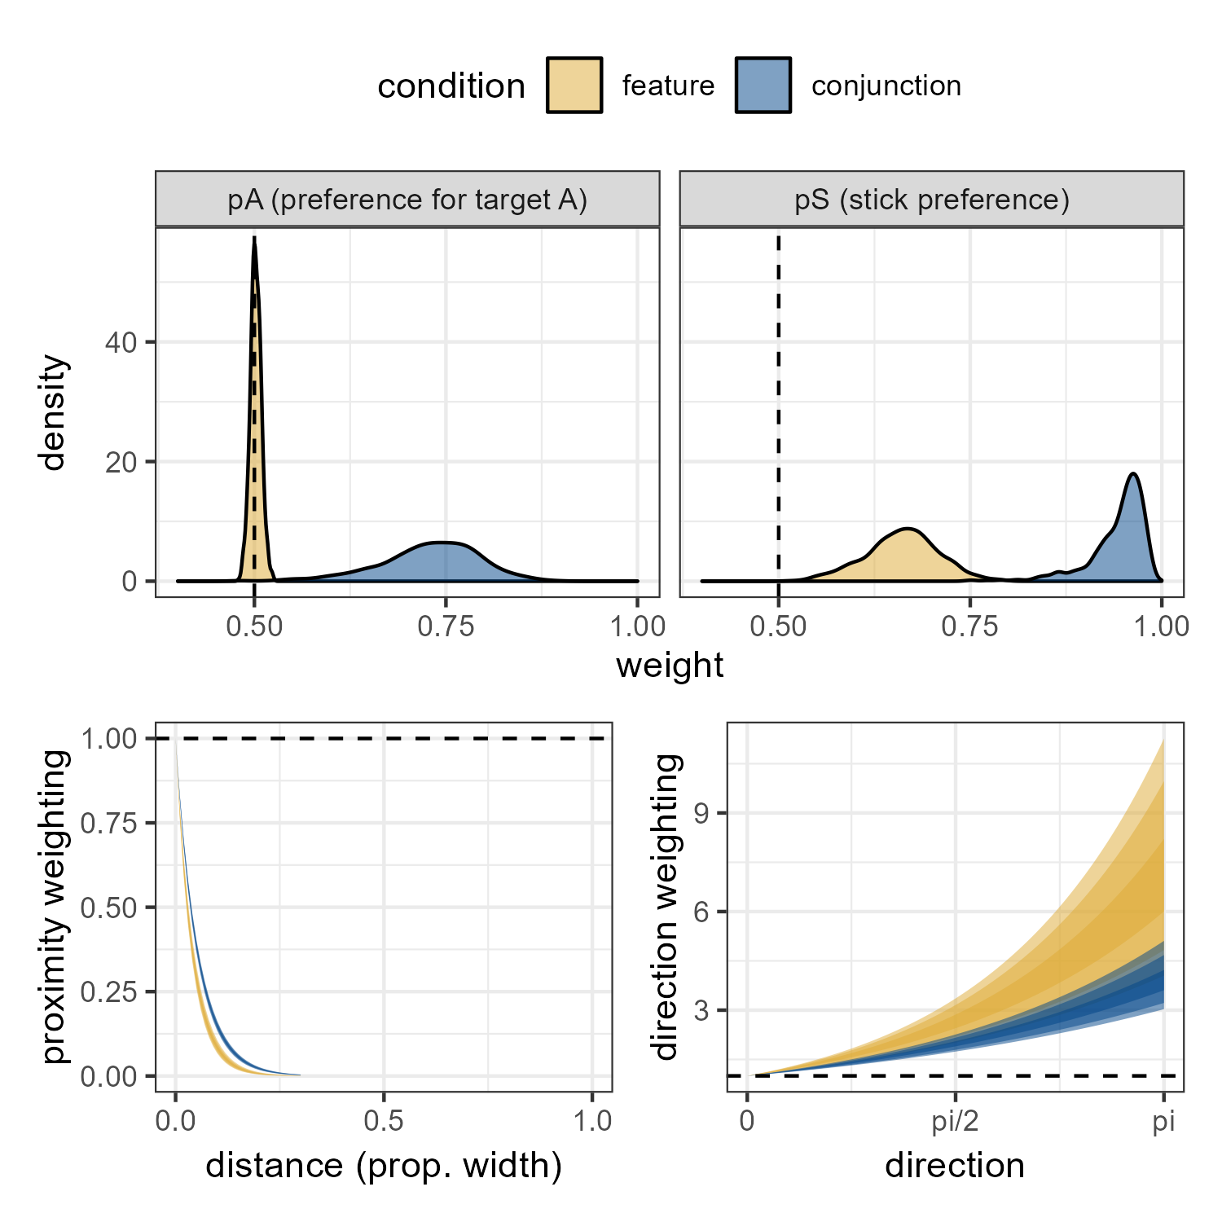
Kristjánsson et al., 2014
We can fit the model to previously published data:
In the feature condition, both target types are equally attractive, while there a 25/75% bias in the conjunction condition

Slide 7
Kristjánsson et al., 2014
We can fit the model to previously published data:
There is a bias to stick with the same target type in both conditions, but it is stronger (~90%) in the conjunction condition compared to the feature condition (~60%).

Slide 8
Kristjánsson et al., 2014
We can fit the model to previously published data:
Participants tend to select targets that are close to the previously selected target, and this preference is even stronger in the feature condition.

Slide 9
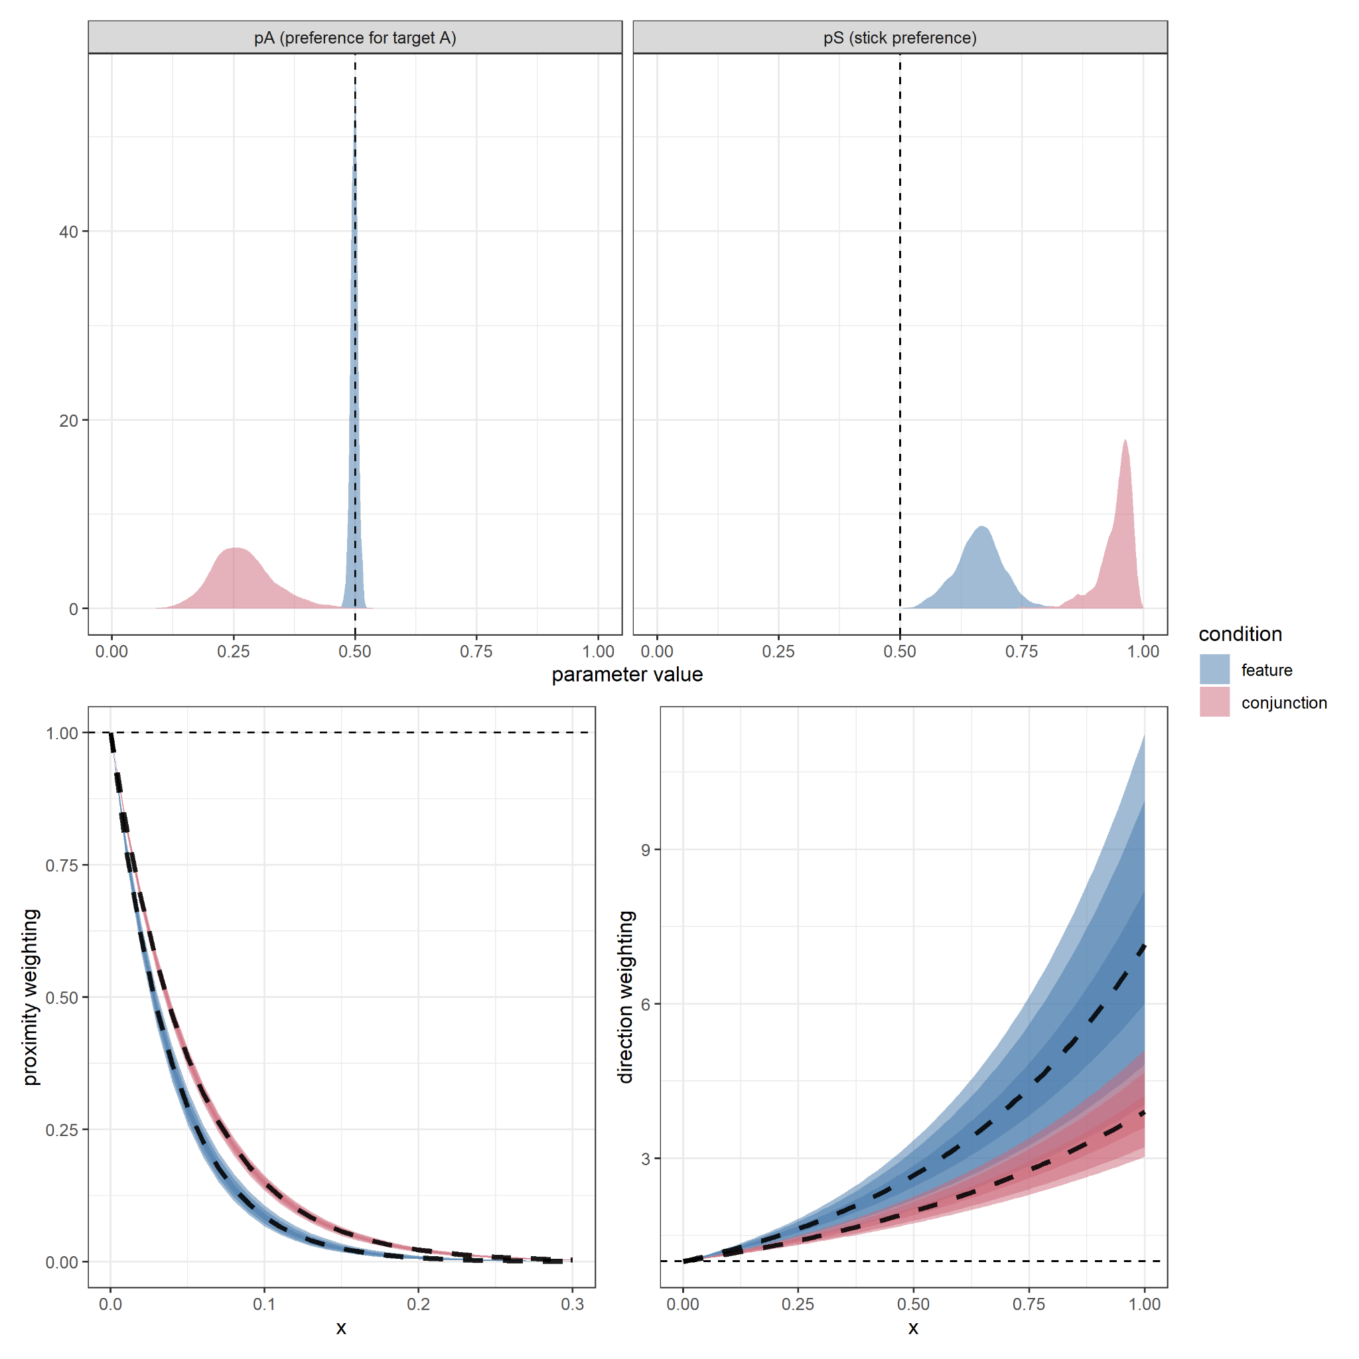
Kristjánsson et al., 2014
We can fit the model to previously published data:
Participants show a (weak) preference for doubling back on themselves and selecting recently passed over targets. Stronger in the feature condition.

Slide 10
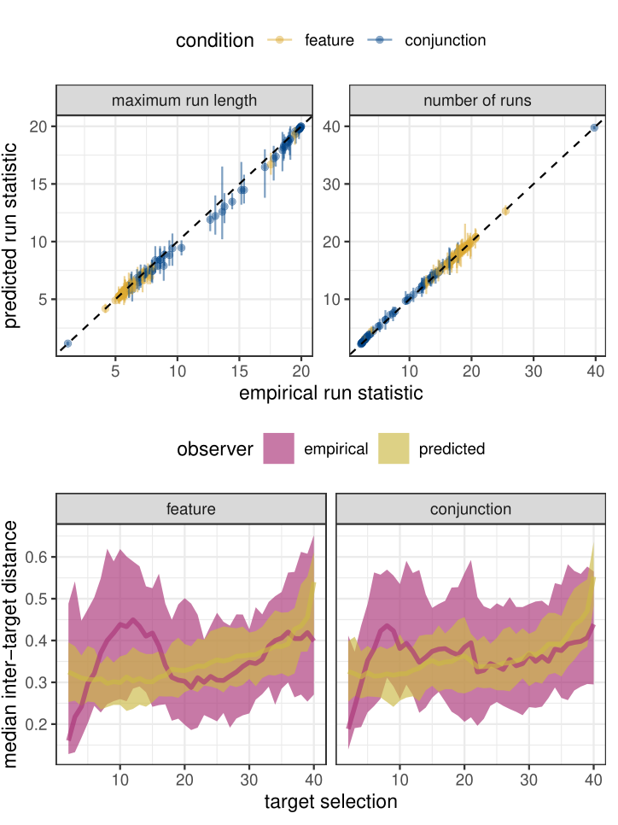
Posterior Predictions
The model does an excellent job of describing human behaviour - at least in terms of the run length statistics.
The inter-target distances over time are reasonable, but our model isn’t yet able to capture some observed dynamics.

Slide 11
Updates on our model
Item-level predictions: how well does the model predict which item will be selected next during the course of a trial?
Individual Differences in foraging organisation: are some participants easier to predict than others?
Initial-target selection: how do people select their initial item?

Slide 12
Item Level Predictions
0.04
0.10
0.65
0.06
0.15

Slide 13
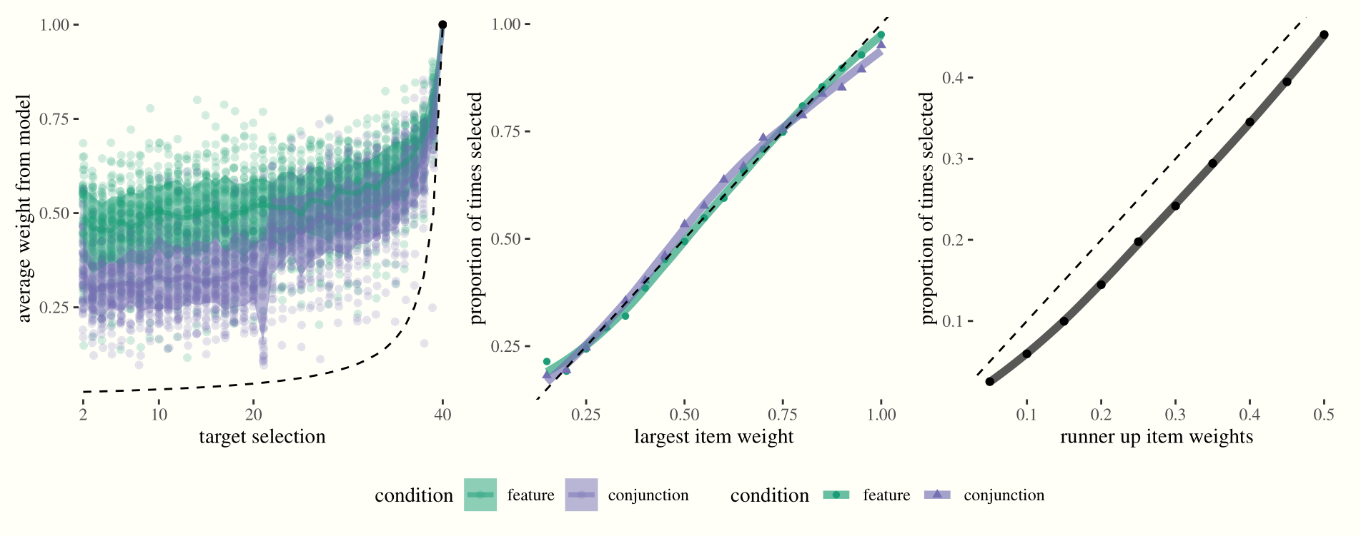
Item Level Predictions
0.04
0.10
0.65
0.06
0.15
Our model easily outperforms a random chance baseline.
Feature foraging is more predictable than Conjunction (unexpected).

Slide 14
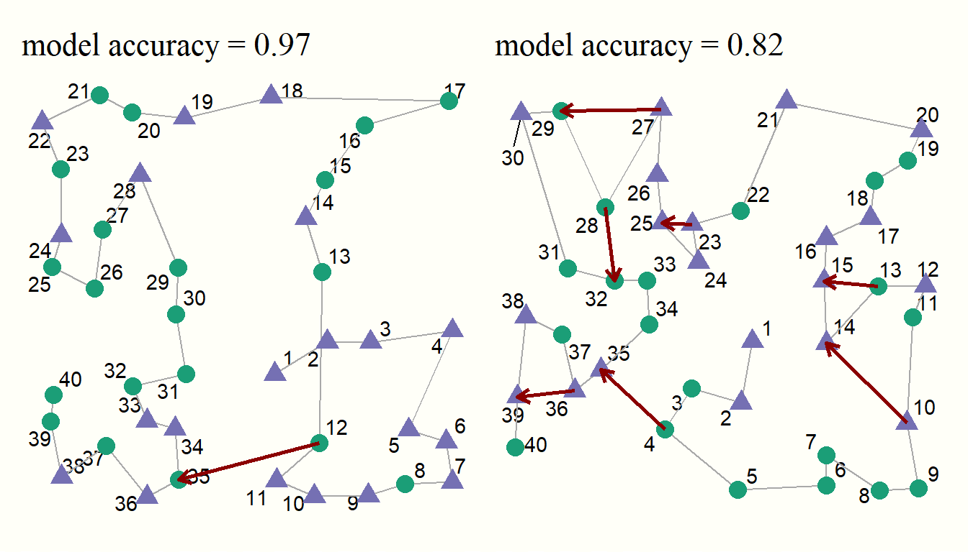
Examples of Predictable Behaviour

Slide 15
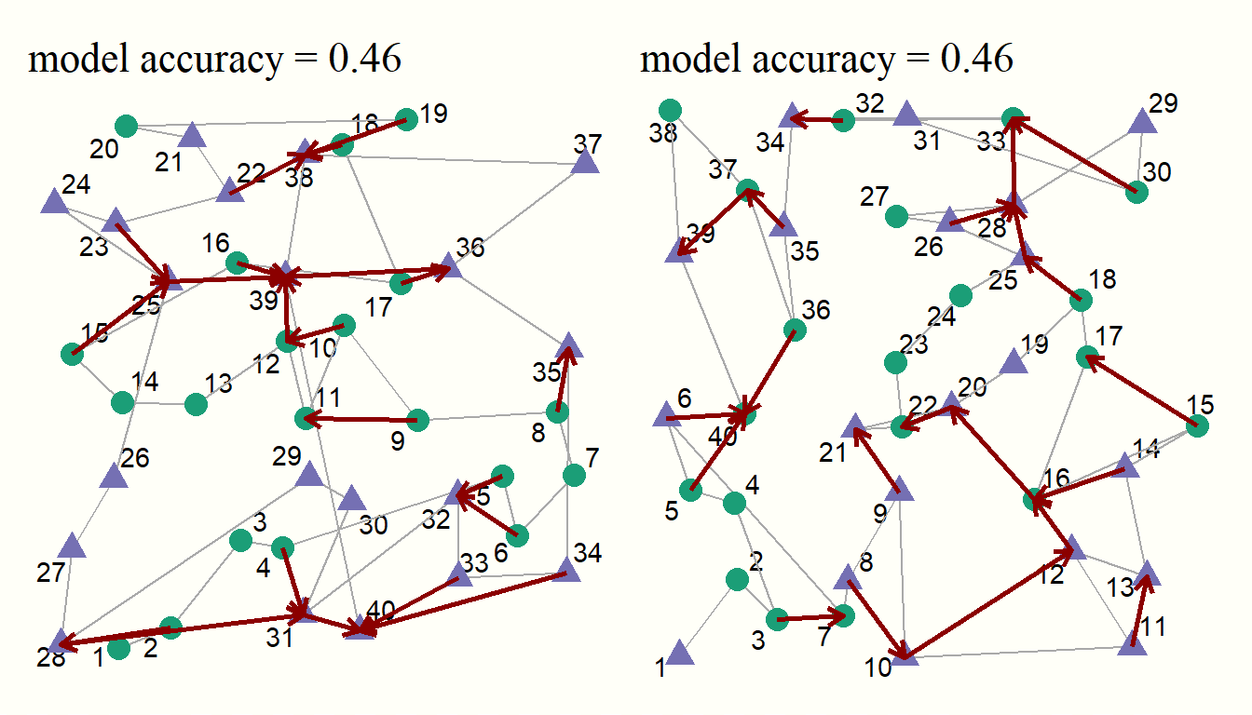
Examples of Unpredictable Behaviour

Slide 16
Examples of Unpredictable Behaviour

Slide 17
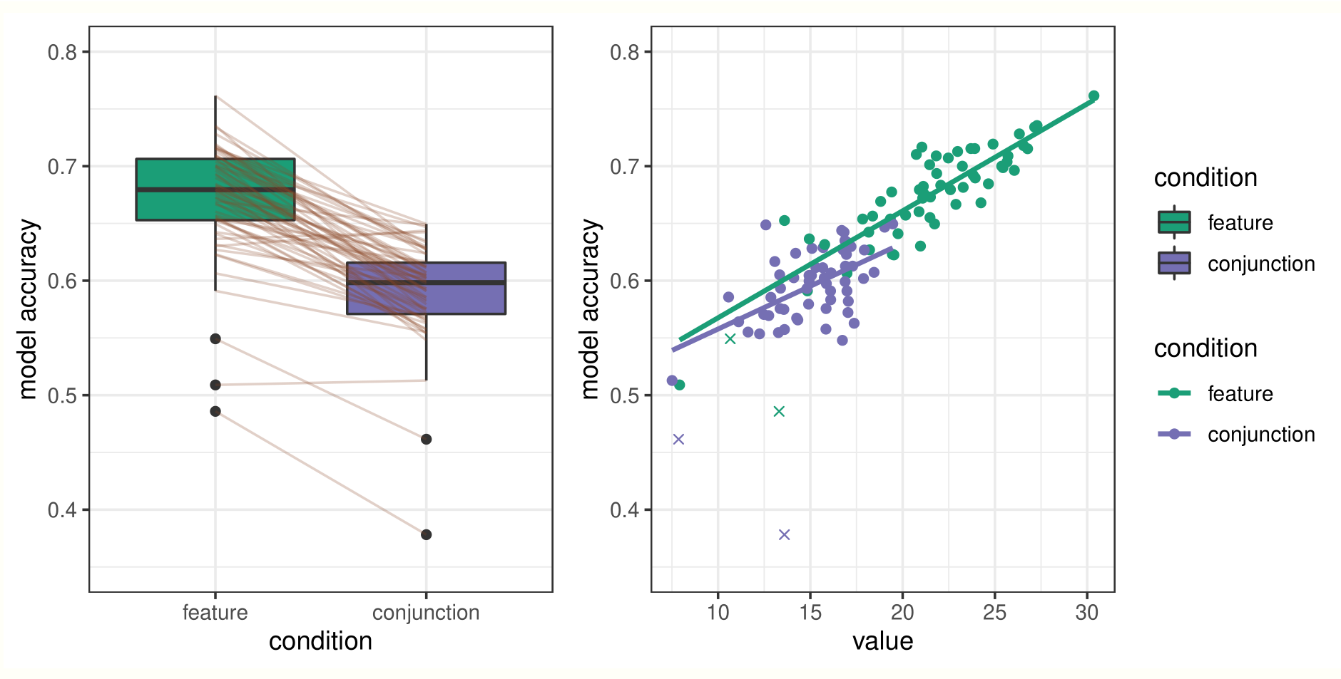
Individual Differences in Predictability
We find large differences in how predictable different participants are.
We also see that feature search is more predictable than conjunction.

Slide 18
Individual Differences in Predictability
We find large differences in how predictable different participants are.
We also see that feature search is more predictable than conjunction.
This is largely explained by differences in proximity weighting.

Slide 19
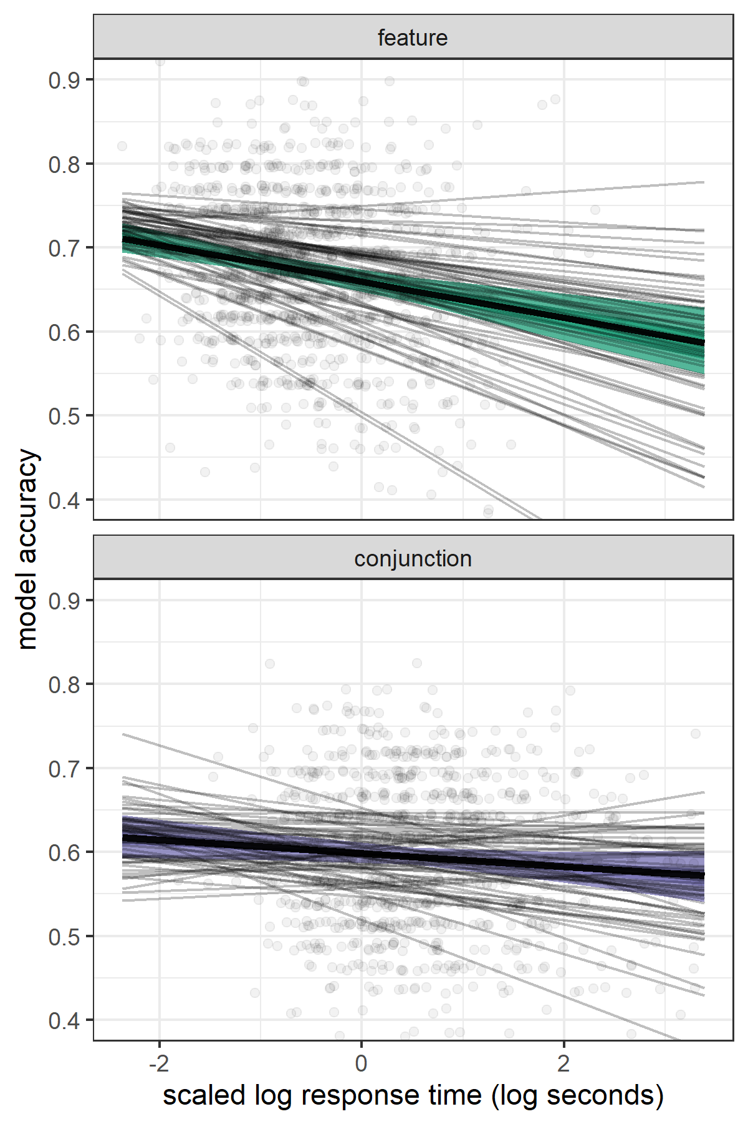
Longer trials are less predictable
Trials that were completed quickly appear to be easier to predict
More organised strategy?
More motivated participants?

Slide 20
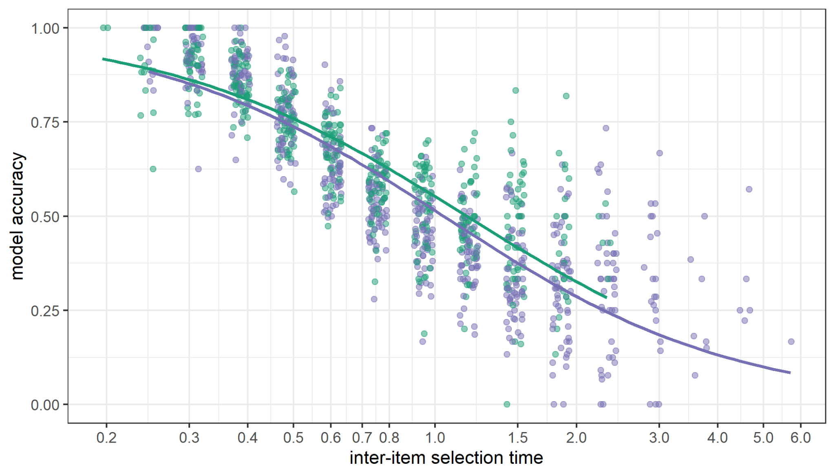
Longer trials are less predictable
Items that are selected more quickly are easier to predict:

Slide 21
Summary
Overall model accuracy is 63%
(compared to chance = 10%)
This depends on:
Number of items left in trial
Participant's proximity bias
Inter-item selection time

Slide 22
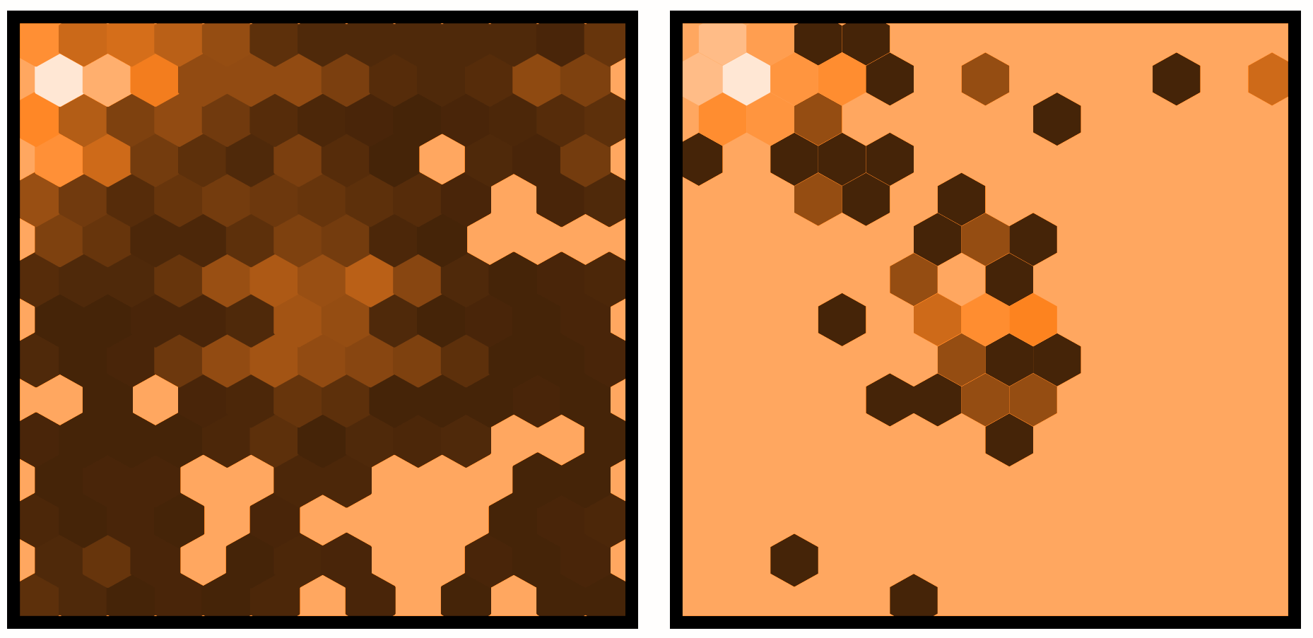
Initial Target Selection

Slide 23
Initial Target Selection
All trials
Average per participant

Slide 24
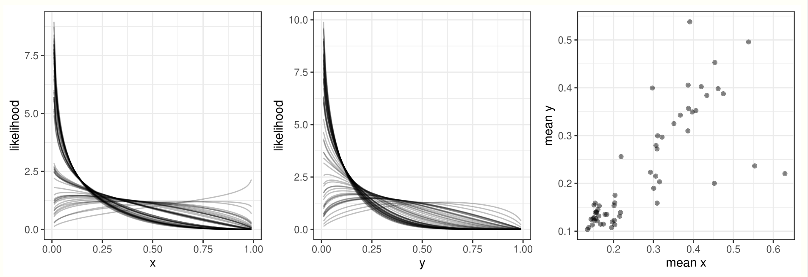
Multi-level Beta-distribution Model
4 parameters per participant = 290 for data from Clarke et al (2022)

Slide 25
Mixture Modelling
We can simplify the previous model by fitting a two-component mixture model:
Rather than fit a two Beta distributions per participant…
Fit two x and two y Beta distributions, and then use a mixing parameter to allow each participant to a mix of the corner and central distributions
This reduces the number of parameters to 8 + 1 per participant = 66

Slide 26
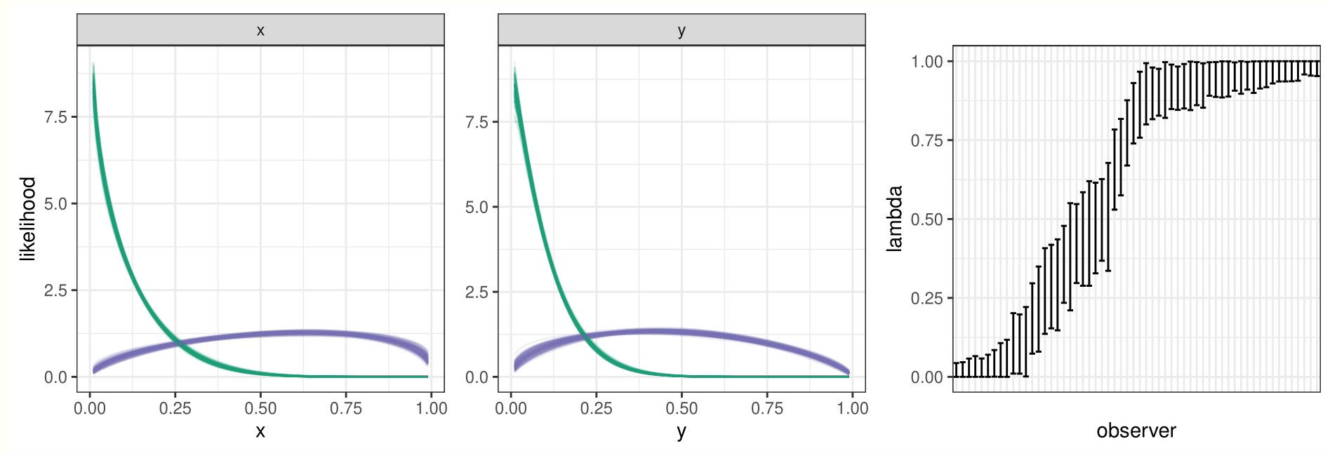
Mixture Modelling
As expected, the model fits a mixture of a central and corner distributions

Slide 27
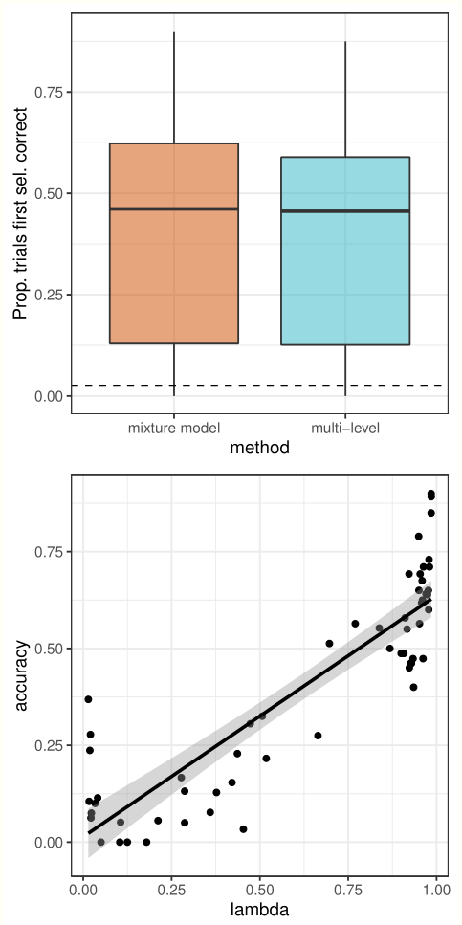
Posterior Predictions
Both methods have an accuracy of around 50%, although there is considerable variation between participants.
This variation appears to be largely accounted for by centre (less predictable) v corner (more predictable) biases.

Slide 28
Conclusions
Future Work
Overall model accuracy is around 60%, although varies with:
number of items left in the current trial
strength of the participant’s proximity bias
Inter-target selection time.
A two-component mixture model can account for individual differences in initial item selection
Use a more sophisticated proximity function to allow for a better fit to data
account for large inter-target distances
Can we use the inter-target selection times to predict when participants will select an unlikely (further away?) target?
which way round does the causal relationship work?
Clarke, A. D. F., Dr, Hunt, A. R., & Hughes, A. (2022, July 25). A Bayesian statistical model is able to predict target-by-target selection behaviour in a human foraging task. https://doi.org/10.31234/osf.io/ah7um

Slide 29
Thanks
Co-authors: Anna Hughes (Essex) and Amelia Hunt (Aberdeen).
Thank you to everybody who has shared data on OSF.
If you’d like help applying these methods to your own data, please do get in touch! (a.clarke@essex.ac.uk, @AlasdairClarke)

